Slide 1
HOP-HMM
David Taub

Slide 2
Outlines
Gene regulation
TFBS & PWMs
HMM
HOP-HMM
Results

Slide 3
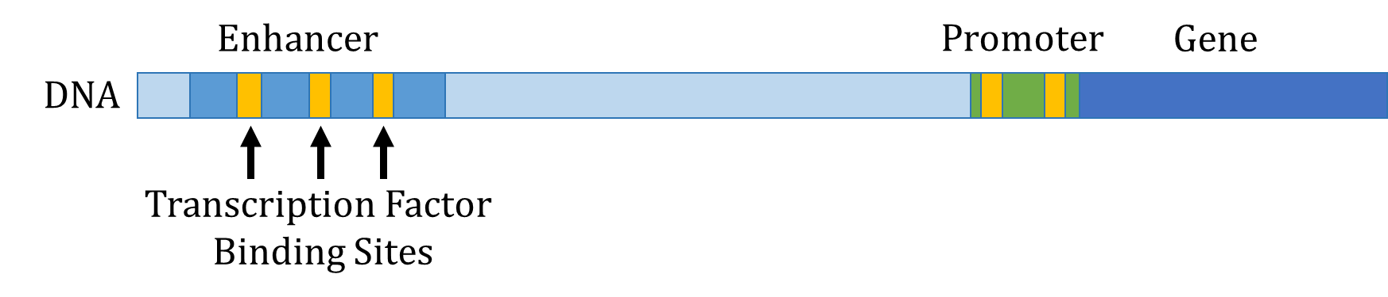

Slide 4
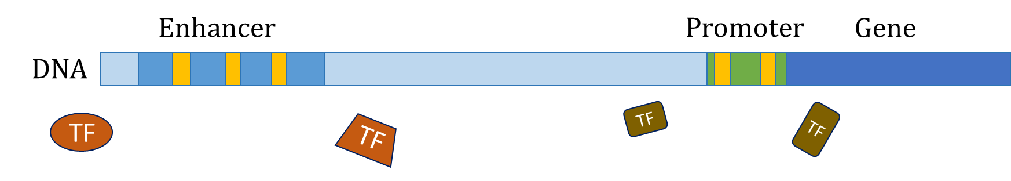

Slide 5
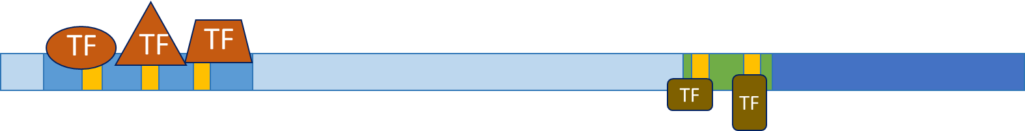

Slide 6


Slide 7
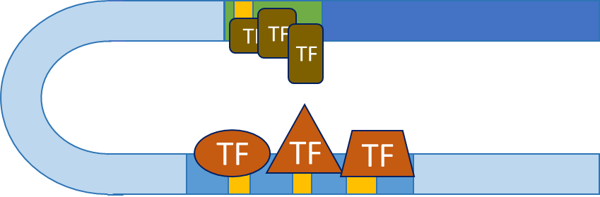

Slide 8
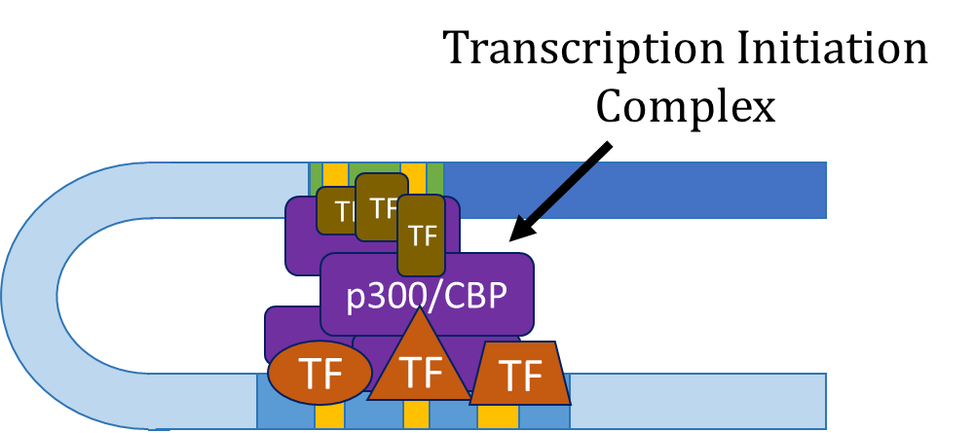

Slide 9
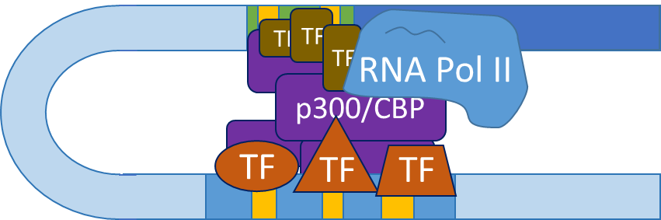

Slide 10
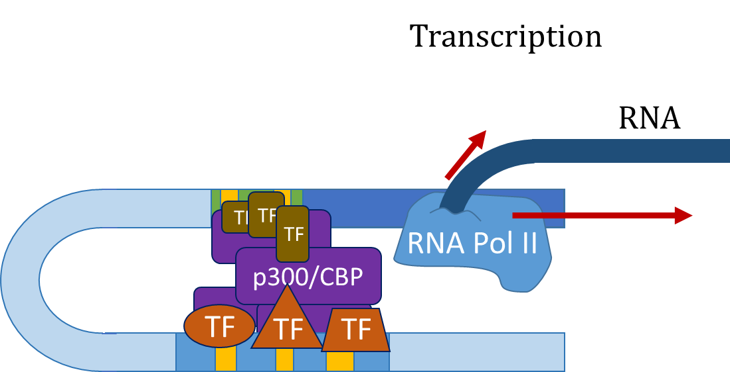

Slide 11
TFBS & PWMs
Enhancer
DNA
TF
TF
Transcription Factor Binding Sites

Slide 12
TFBS & PWMs
…CGAGCTACTTTATTAAGACATTACGTTACAGAGATAA…
Enhancer
DNA
TF
TF
Transcription Factor Binding Sites

Slide 13
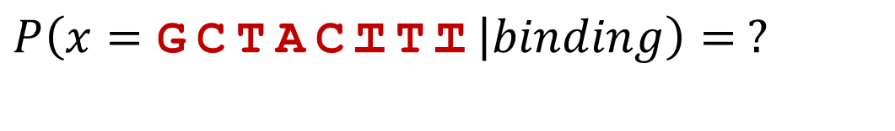
TFBS & PWMs
…CGAGCTACTTTATTAAGACATTACGTTACAGAGATAA…
$$P\left(x=\text{GCTACTTT} | binding\right)= ?$$

Slide 14
TFBS & PWMs
…CGAGCTACTTTATTAAGACATTACGTTACAGAGATAA…
$$P\left(x=\text{GCTACTTT} | binding\right)= ?$$
other binding sites
(ChIP-seq)
ACTACTTT
CCGACTTT
GTAACTCA
GGGAGGCT
GTGGCGCT
GGAACGTG
GCTACTTT

Slide 15
TFBS & PWMs
…CGAGCTACTTTATTAAGACATTACGTTACAGAGATAA…
$$P\left(x=\text{GCTACTTT} | binding\right)= ?$$
other binding sites
(ChIP-seq)
A:10260001
C:13306030
G:52011301
T:02200445
ACTACTTT
CCGACTTT
GTAACTCA
GGGAGGCT
GTGGCGCT
GGAACGTG
GCTACTTT

Slide 16
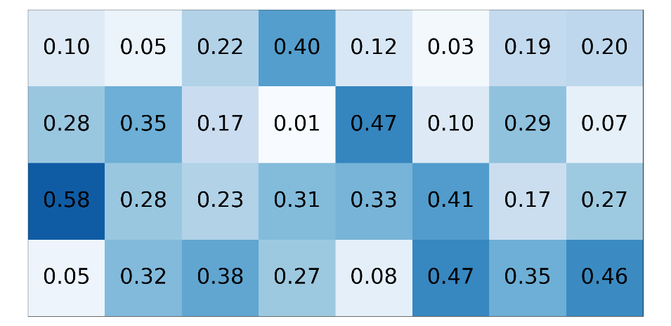
TFBS & PWMs
…CGAGCTACTTTATTAAGACATTACGTTACAGAGATAA…
$$P\left(x=\text{GCTACTTT} | binding\right)= ?$$
other binding sites
(ChIP-seq)
PWM (W)
A:10260001
C:13306030
G:52011301
T:02200445
ACTACTTT
CCGACTTT
GTAACTCA
GGGAGGCT
GTGGCGCT
GGAACGTG
GCTACTTT

Slide 17
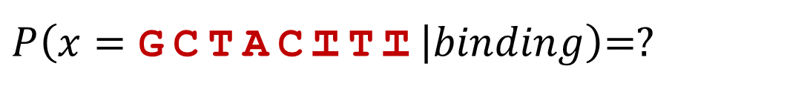
TFBS & PWMs
…CGAGCTACTTTATTAAGACATTACGTTACAGAGATAA…
$P\left(x=\text{GCTACTTT} | binding\right)$=?
PWM (W)

Slide 18
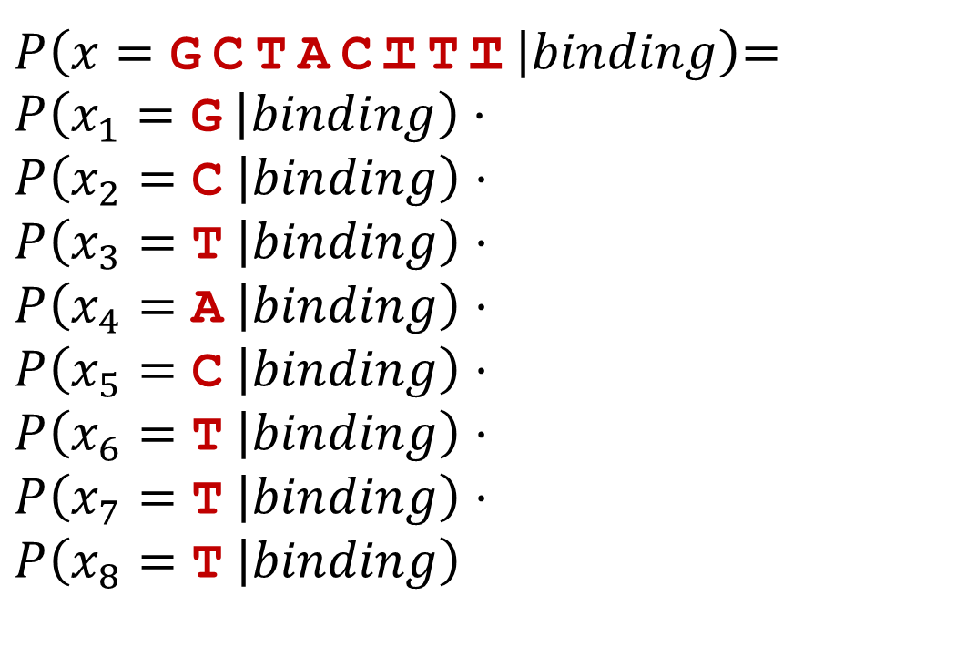
TFBS & PWMs
…CGAGCTACTTTATTAAGACATTACGTTACAGAGATAA…
$P\left(x=\text{GCTACTTT} | binding\right)$=
$$P\left(x_{1}=\text{G} | binding\right)⋅$$
$$P\left(x_{2}=\text{C} | binding\right)⋅$$
$$P\left(x_{3}=\text{T} | binding\right)⋅$$
$$P\left(x_{4}=\text{A} | binding\right)⋅$$
$$P\left(x_{5}=\text{C} | binding\right)⋅$$
$$P\left(x_{6}=\text{T} | binding\right)⋅$$
$$P\left(x_{7}=\text{T} | binding\right)⋅$$
$$P\left(x_{8}=\text{T} | binding\right)$$
positional independence assumption
PWM (W)

Slide 19
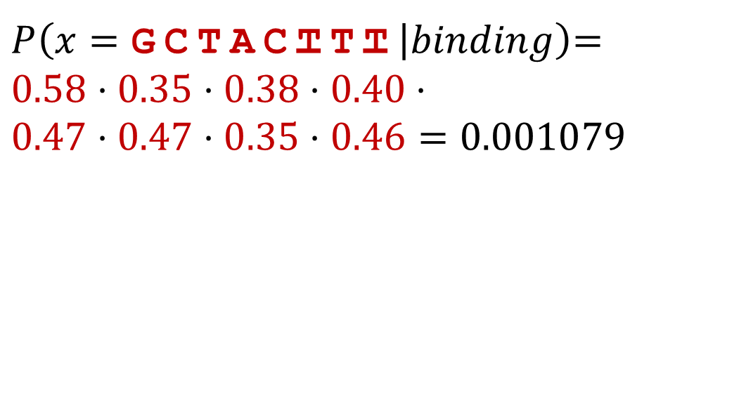
TFBS & PWMs
…CGAGCTACTTTATTAAGACATTACGTTACAGAGATAA…
$P\left(x=\text{GCTACTTT} | binding\right)$=
$$0.58⋅0.35⋅0.38⋅0.40⋅$$
$$0.47⋅0.47⋅0.35⋅0.46=\text{0}\text{.}\text{001079}$$
PWM (W)

Slide 20
TFBS & PWMs
…CGAGCTACTTTATTAAGACATTACGTTACAGAGATAA…
$P\left(x=\text{GCTACTTT} | binding\right)$=
$$0.58⋅0.35⋅0.38⋅0.40⋅$$
$$0.47⋅0.47⋅0.35⋅0.46=\text{0}\text{.}\text{001079}$$
PWM (W)
Small number,
log likelihood is more convenient

Slide 21
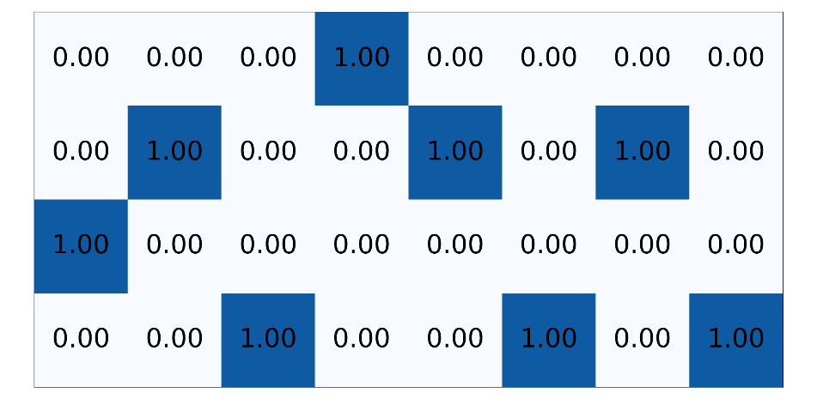

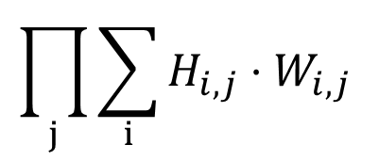
Using PWMs
…CGACTCCGTATA…
One-hot encoding (H)
PWM (W)
$$\prod_{j}{\sum_{i}{H_{i,j}}⋅W_{i,j}}$$
*

Slide 22
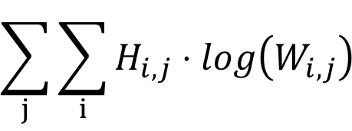
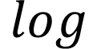
Using PWMs
…CGACTCCGTATA…
One-hot encoding (H)
PWM (W)
$$\sum_{j}{\sum_{i}{H_{i,j}}⋅log\left(W_{i,j}\right) }$$
*
$$log$$

Slide 23
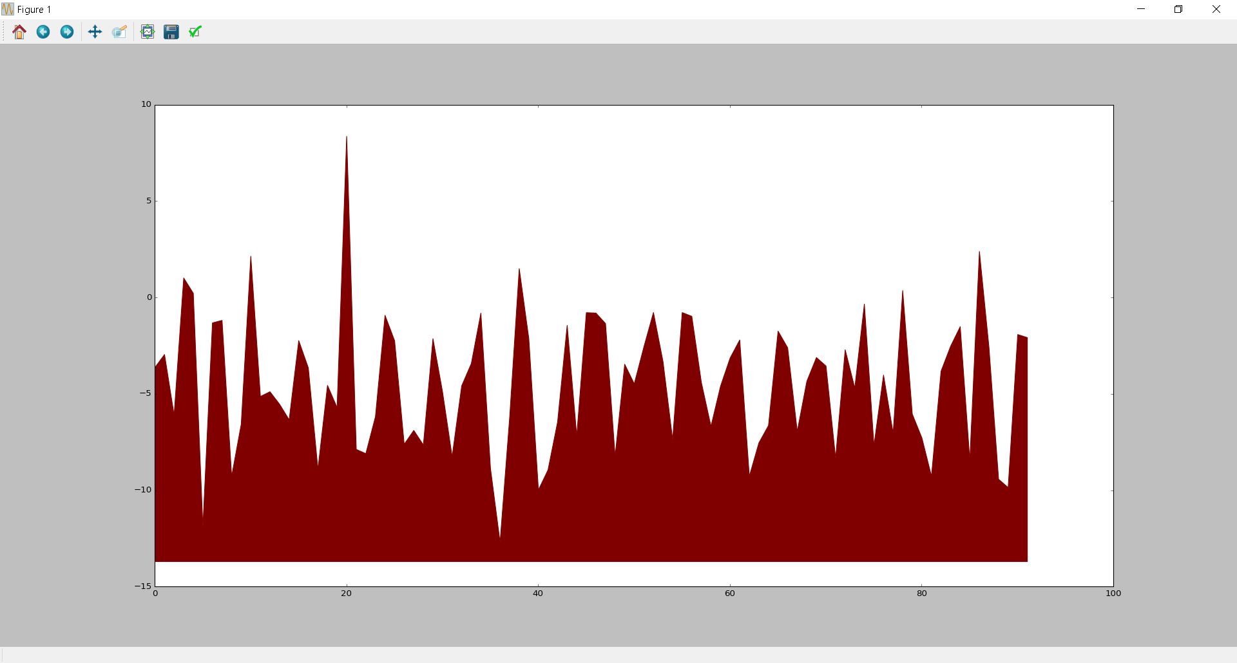
Using PWMs
…CGACTCCGTATA…
One-hot encoding (H)
PWM (W)
$$\sum_{j}{\sum_{i}{H_{i,j}}⋅log\left(W_{i,j}\right) }$$
*
$$log$$
Log likelihood of TF binding
Location in sequence

Slide 24
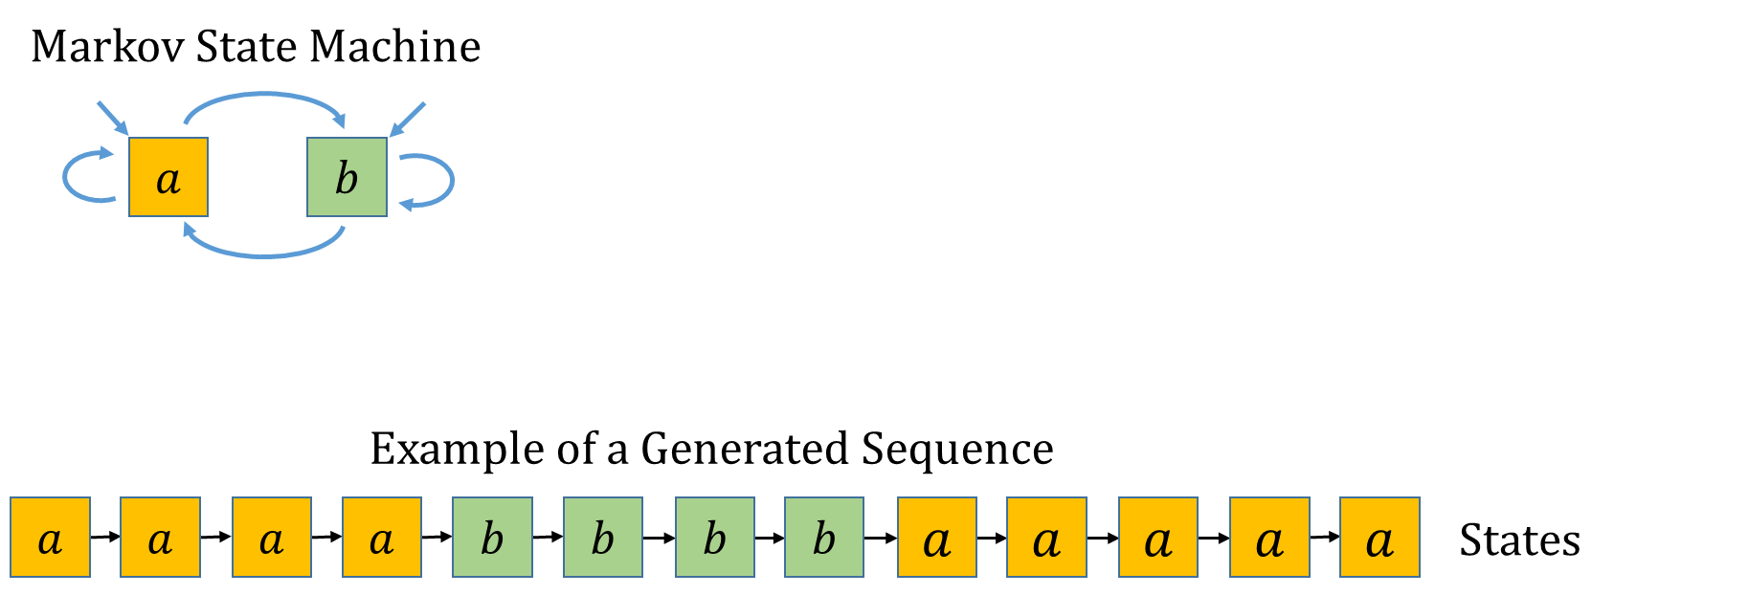
Hidden Markov Model

Slide 25
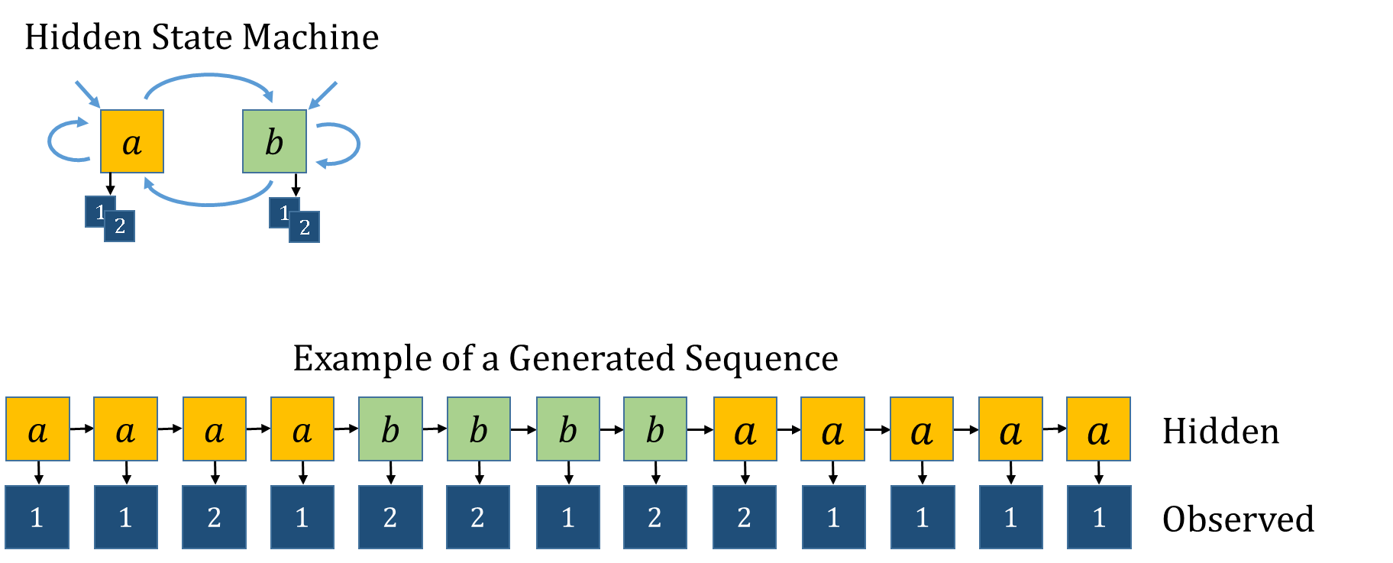
Hidden Markov Model

Slide 26
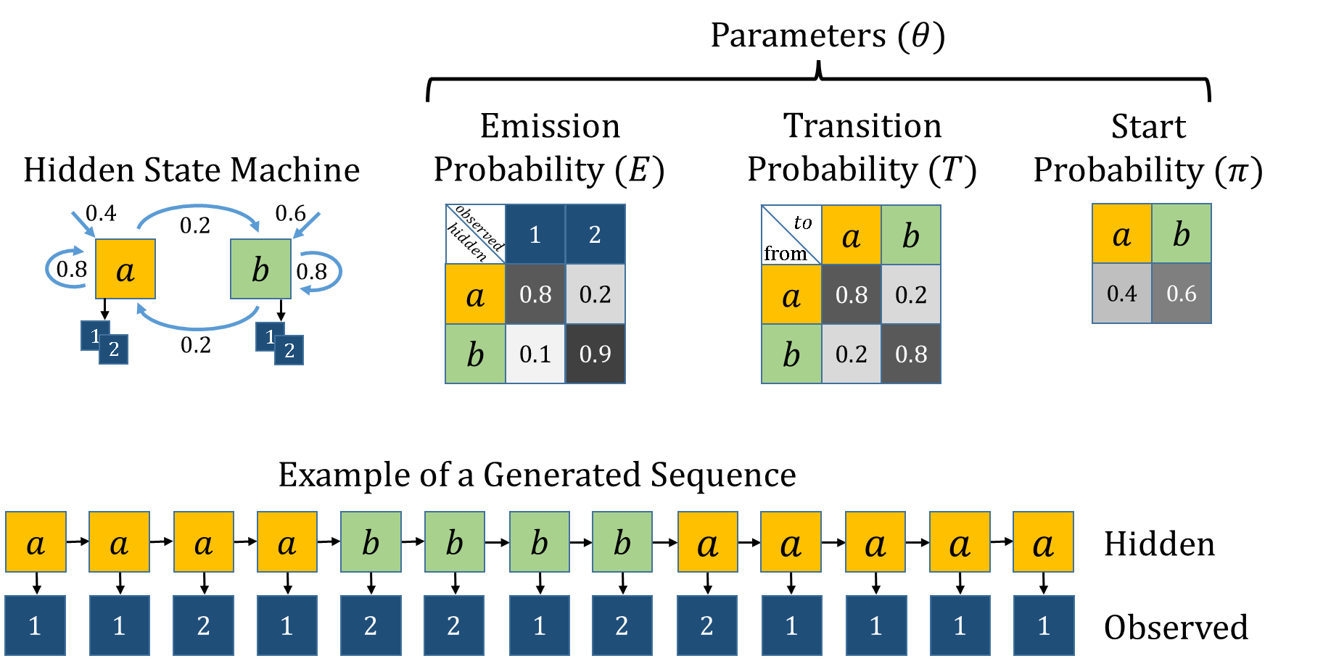
Hidden Markov Model

Slide 27
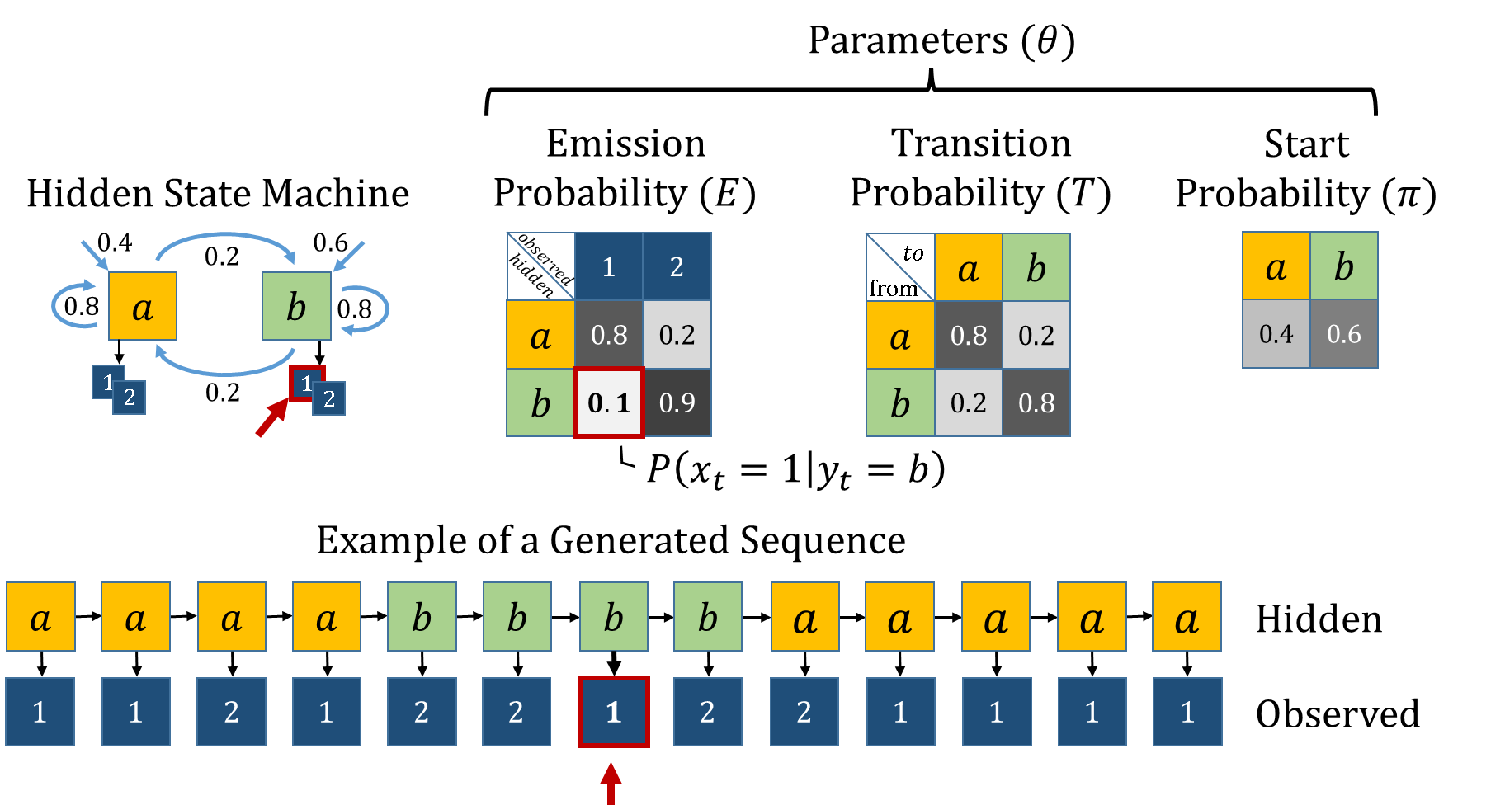
Hidden Markov Model

Slide 28
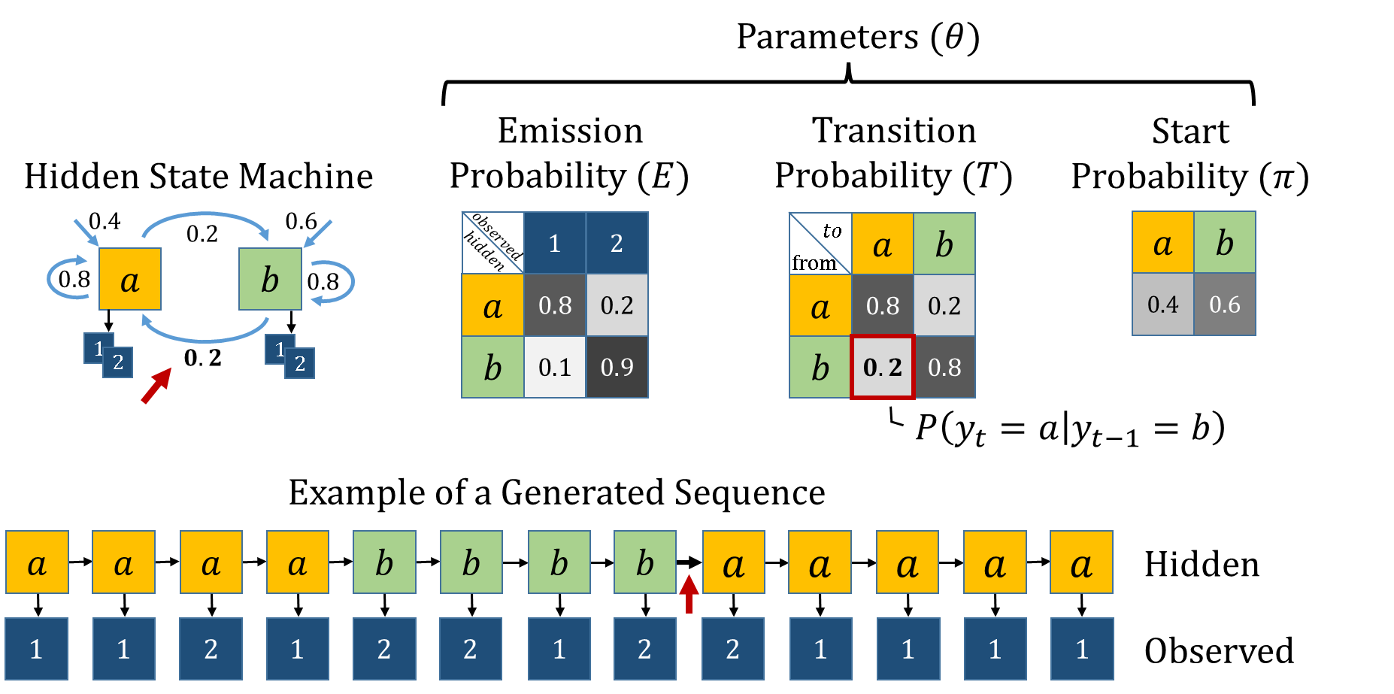
Hidden Markov Model

Slide 29
TODO
Likelihood
Postirior
Baum-Welch Algo

Slide 30
Enhancer
DNA
TF
TF

Slide 31
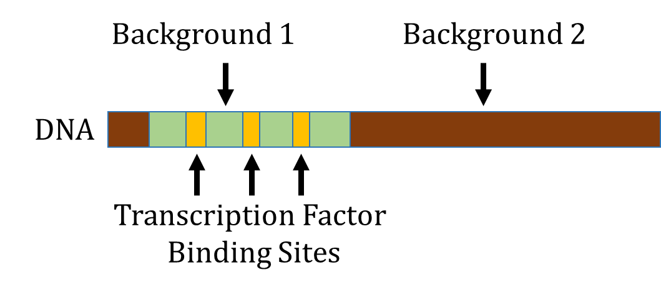

Slide 32
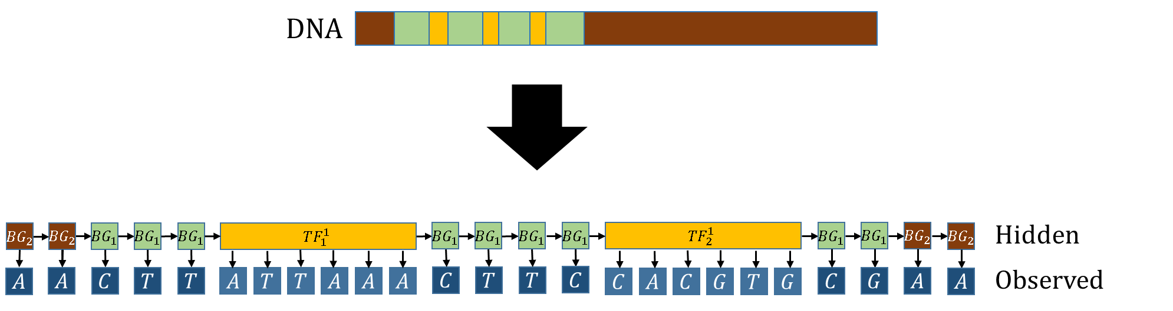

Slide 34
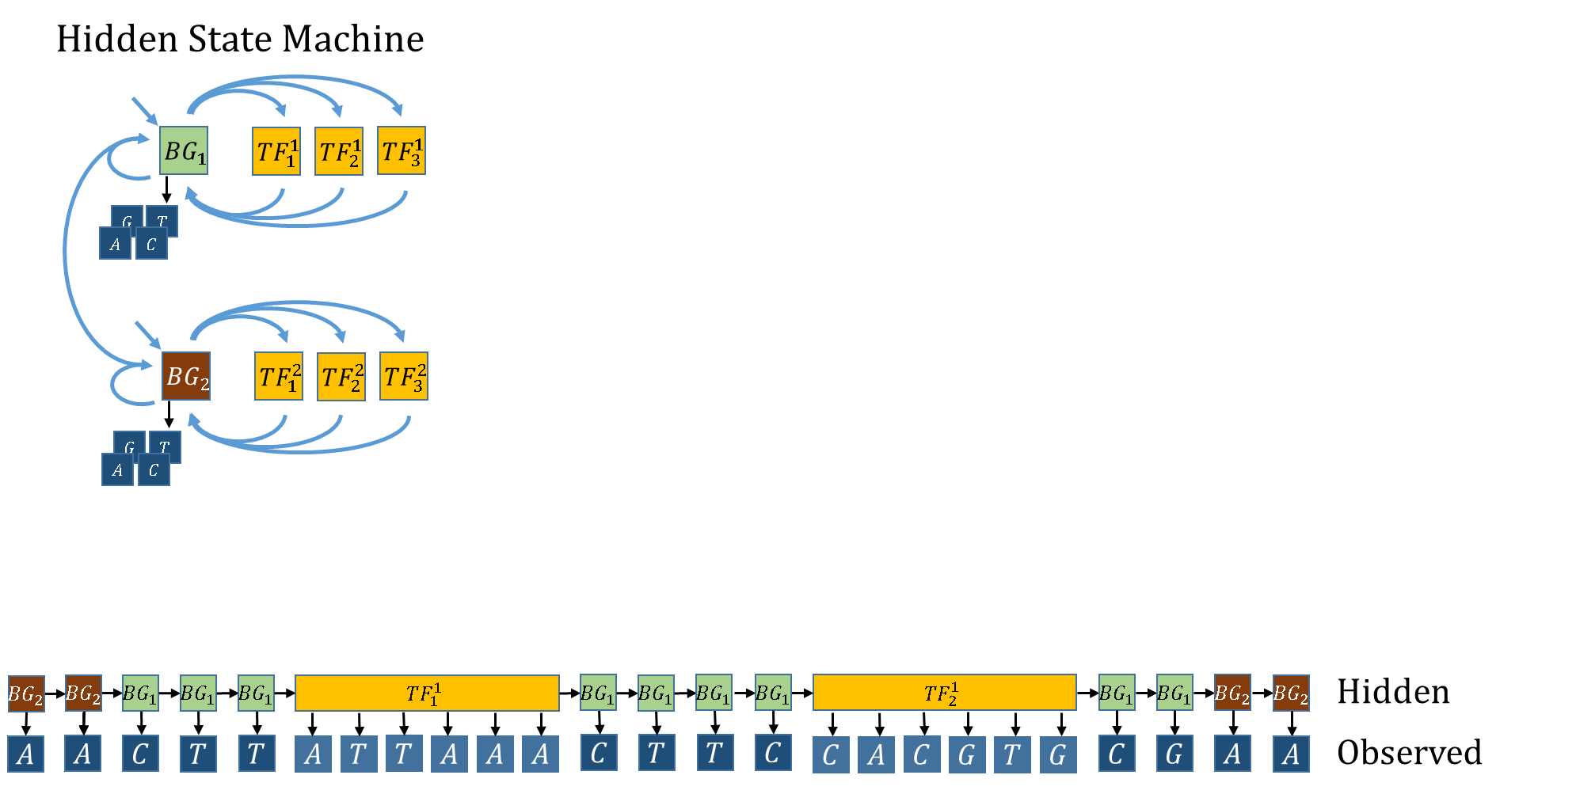

Slide 35
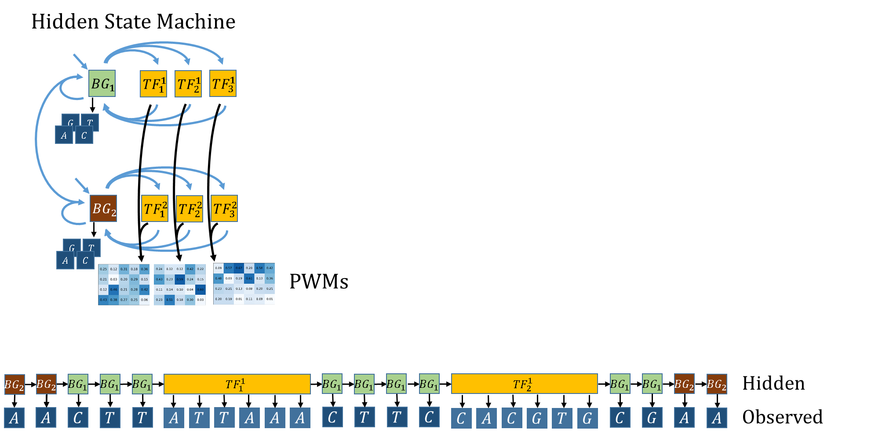

Slide 36
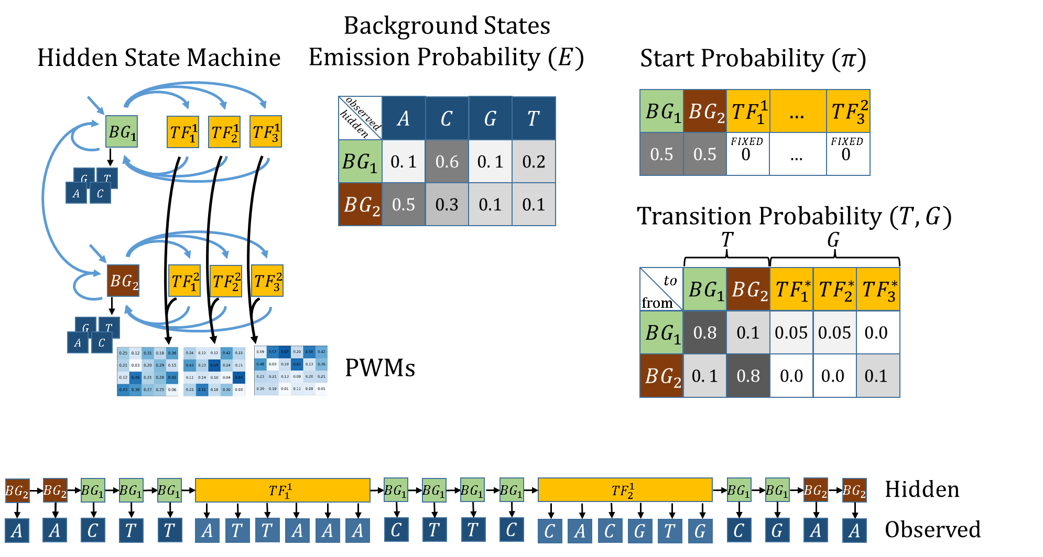

Slide 37


Slide 38
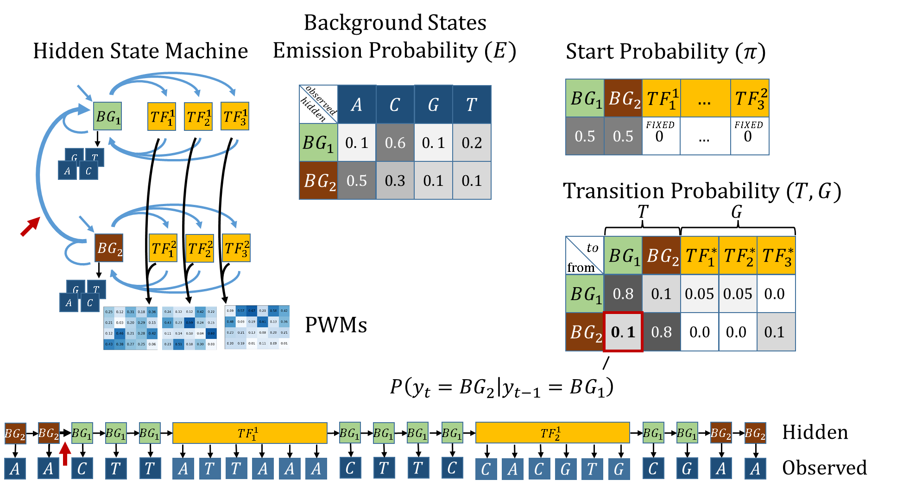

Slide 39
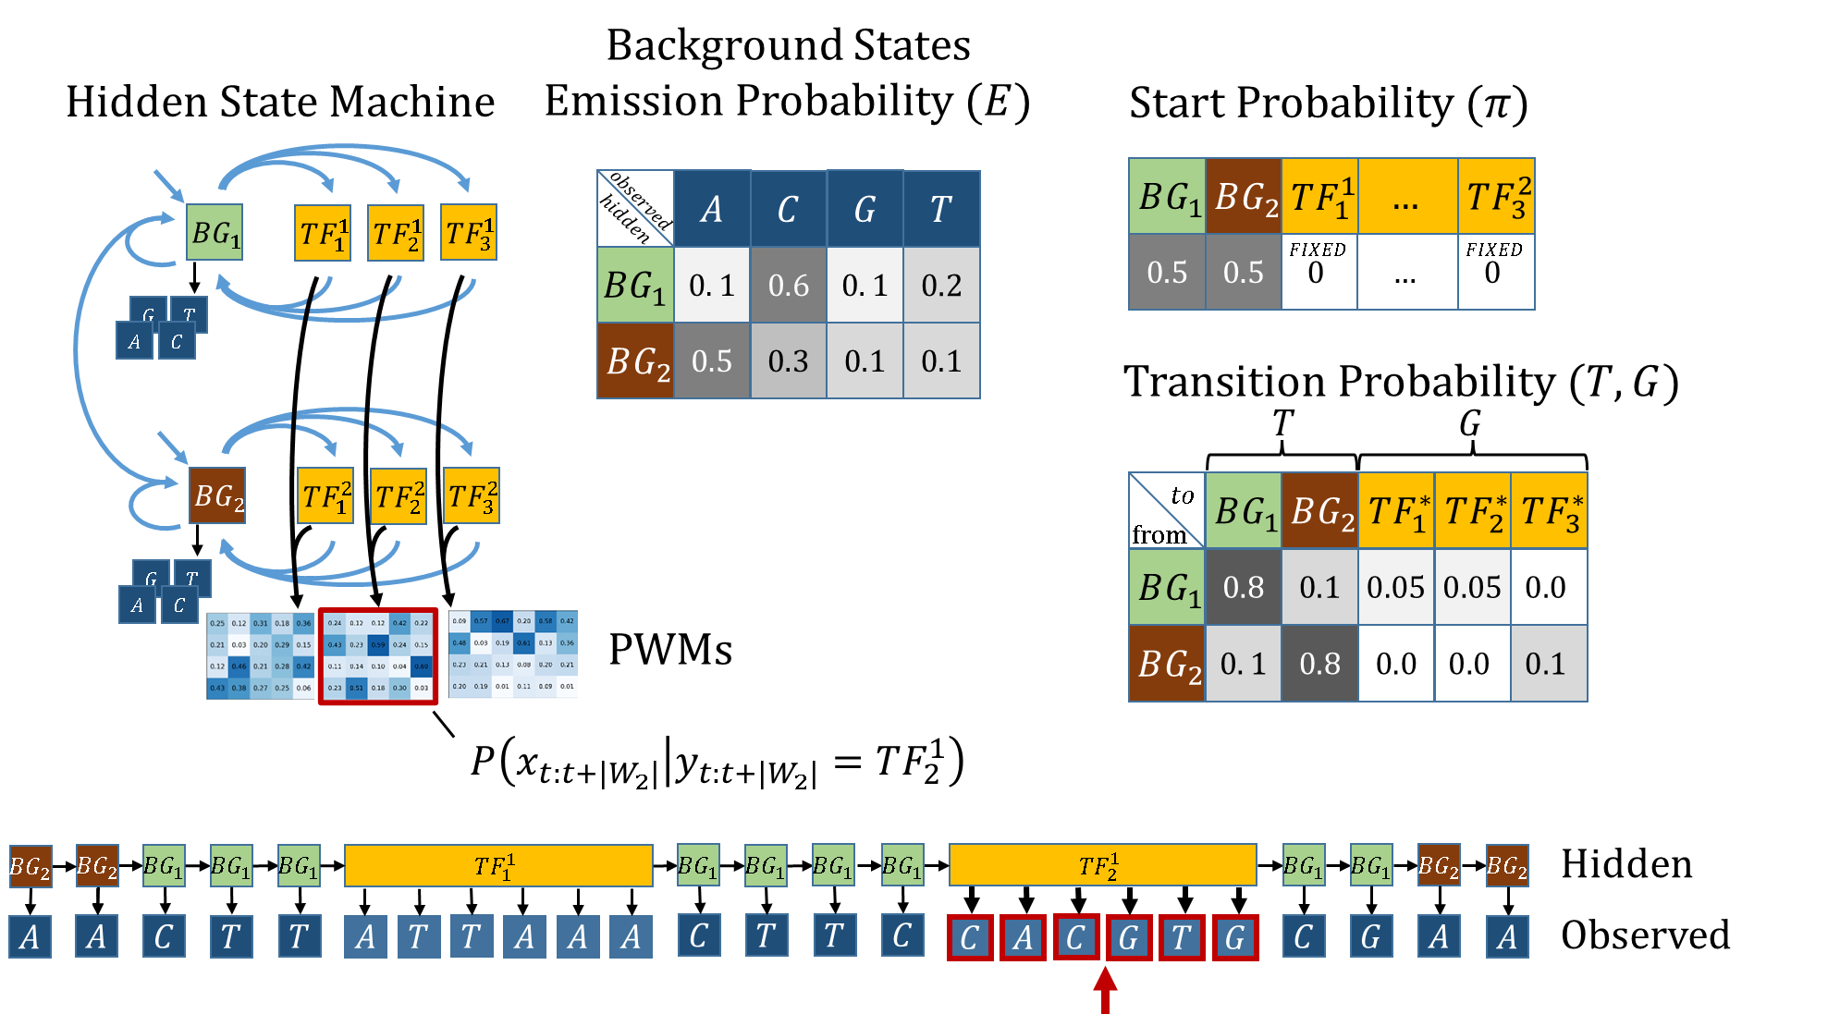

Slide 40


Slide 41
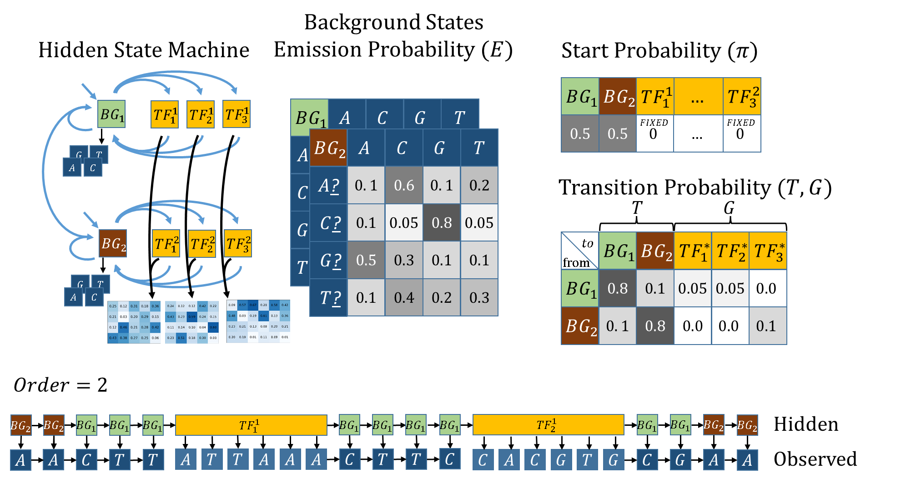

Slide 42
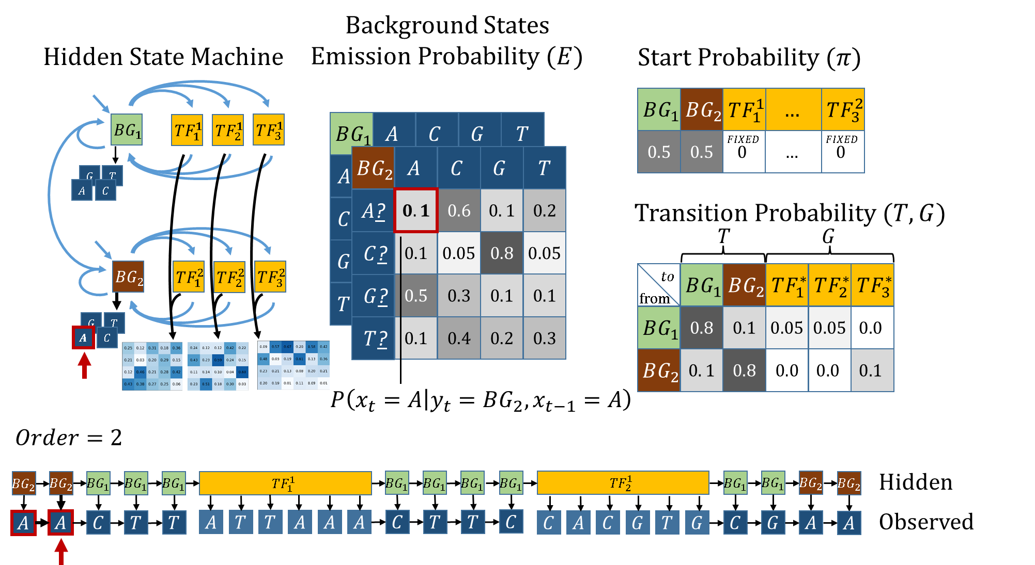

Slide 43
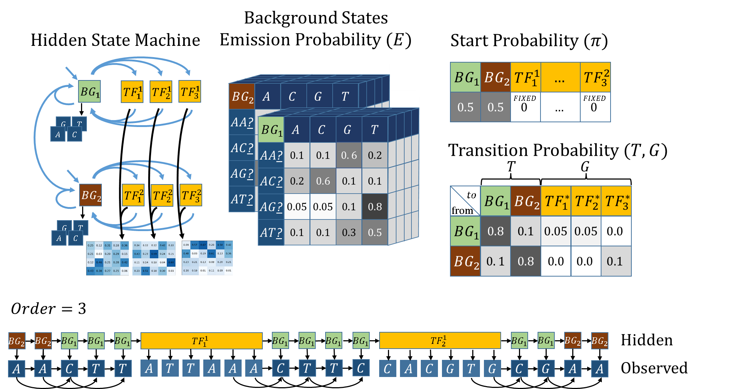

Slide 44
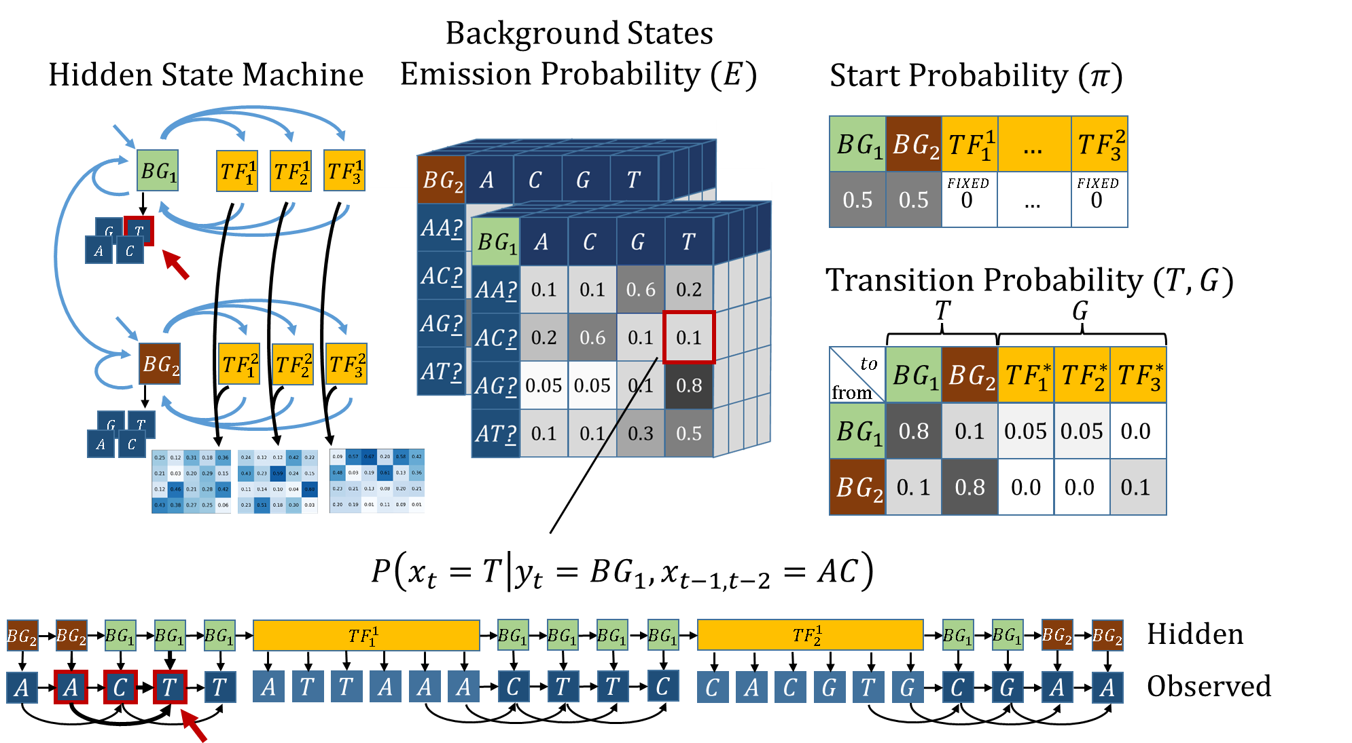

Slide 45
Posterior Probability

Slide 46
Posterior Probability
What is it?
Calculation
HOP-HMM Adaptations

Slide 47
Posterior Probability- What is it?

Slide 48
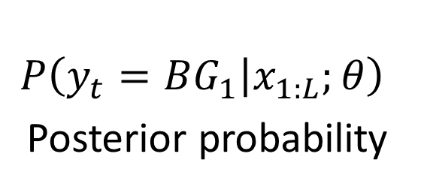
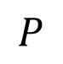
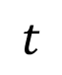
Posterior Probability- What is it?
$$P$$
$$P\left(y_{t}=BG_{1} | x_{1:L};θ\right)$$
Posterior probability
$$t$$

Slide 49
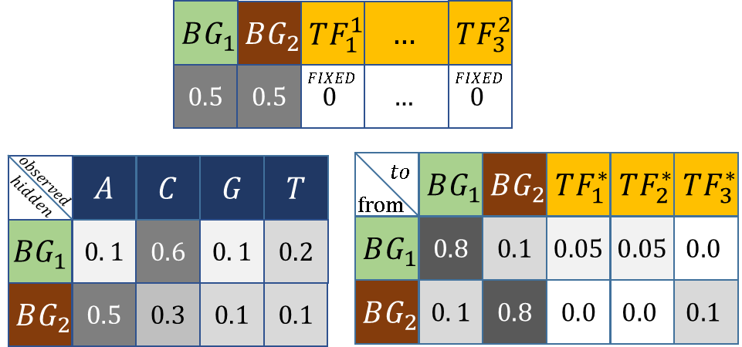
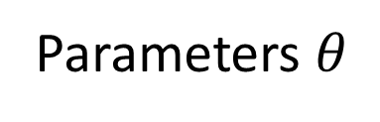
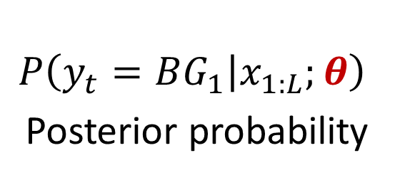
Posterior Probability- What is it?
Given:
$$P$$
Parameters $θ$
$$P\left(y_{t}=BG_{1} | x_{1:L};θ\right)$$
Posterior probability
$$t$$

Slide 50
Posterior Probability
$$P\left(y_{t}=BG_{1} | x_{1:L};θ\right)$$
Posterior probability

Slide 51
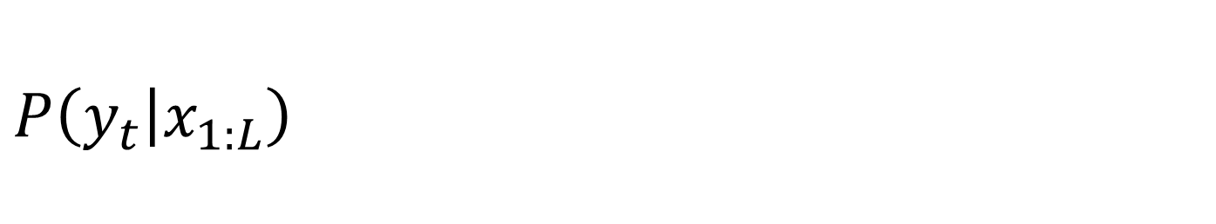
Posterior Probability - Calculation
$$P\left(y_{t} | x_{1:L}\right)$$

Slide 52
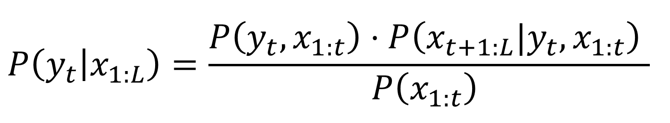
Posterior Probability - Calculation
$$P\left(y_{t} | x_{1:L}\right)=\frac{P\left(y_{t},x_{1:t}\right)⋅P\left({x_{t+1:L}|y}_{t},x_{1:t}\right) }{P\left(x_{1:t}\right) }$$

Slide 53
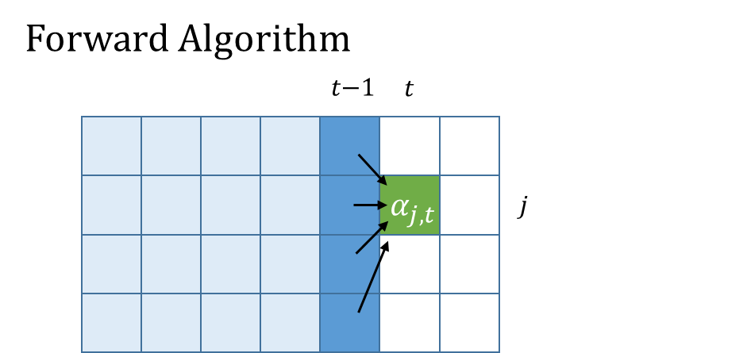
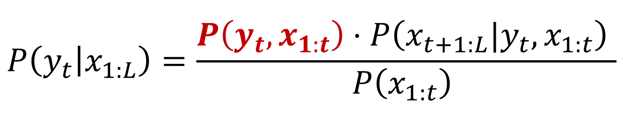
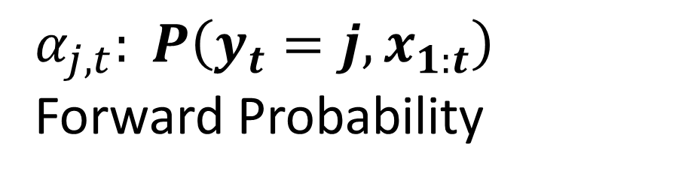
Posterior Probability - Calculation
$$P\left(y_{t} | x_{1:L}\right)=\frac{P\left(y_{t},x_{1:t}\right)⋅P\left({x_{t+1:L}|y}_{t},x_{1:t}\right) }{P\left(x_{1:t}\right) }$$
$α_{j,t}: P\left(y_{t}=j,x_{1:t}\right)$ Forward Probability

Slide 54
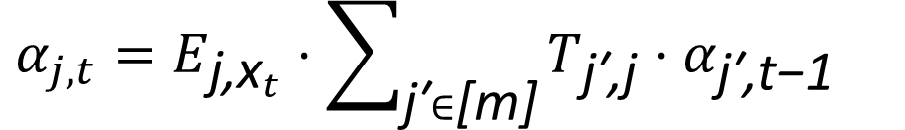
Posterior Probability - Calculation
$$P\left(y_{t} | x_{1:L}\right)=\frac{P\left(y_{t},x_{1:t}\right)⋅P\left({x_{t+1:L}|y}_{t},x_{1:t}\right) }{P\left(x_{1:t}\right) }$$
$α_{j,t}: P\left(y_{t}=j,x_{1:t}\right)$ Forward Probability
$$α_{j,t}=E_{{\text{j}\text{,}\text{x}}_{t}}⋅\sum_{\text{j}\text{′}∈\text{[}\text{m}\text{]}}{T_{\text{j}\text{′}\text{,}\text{j}}⋅α_{\text{j}\text{′}\text{,}\text{t}\text{−}\text{1}}}$$

Slide 55
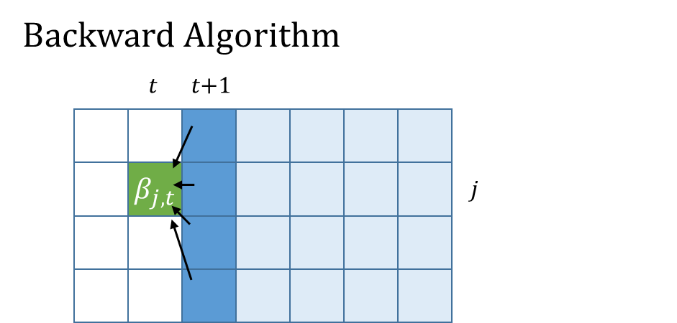
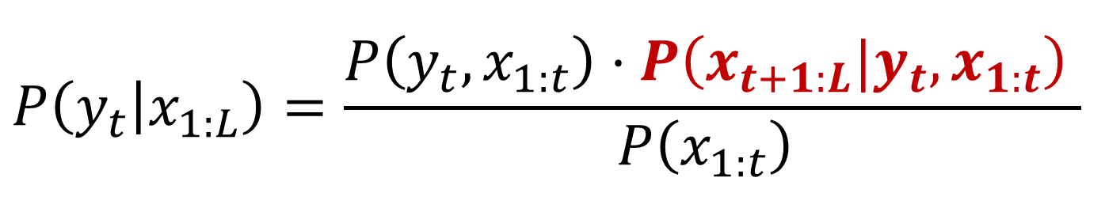
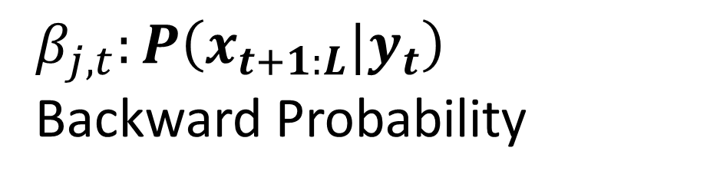
Posterior Probability - Calculation
$$P\left(y_{t} | x_{1:L}\right)=\frac{P\left(y_{t},x_{1:t}\right)⋅P\left({x_{t+1:L}|y}_{t},x_{1:t}\right) }{P\left(x_{1:t}\right) }$$
$$β_{j,t}:P\left({x_{t+1:L}|y}_{t}\right)$$
Backward Probability

Slide 56
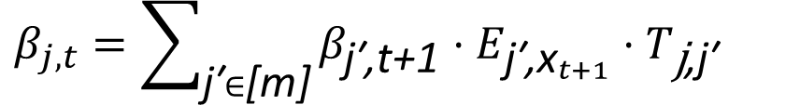
Posterior Probability - Calculation
$$P\left(y_{t} | x_{1:L}\right)=\frac{P\left(y_{t},x_{1:t}\right)⋅P\left({x_{t+1:L}|y}_{t},x_{1:t}\right) }{P\left(x_{1:t}\right) }$$
$$β_{j,t}:P\left({x_{t+1:L}|y}_{t}\right)$$
Backward Probability
$$β_{j,t}=\sum_{\text{j}\text{′}∈\text{[}\text{m}\text{]}}{β_{\text{j}\text{′}\text{,}\text{t}\text{+}\text{1}}⋅E_{{\text{j}\text{′}\text{,}\text{x}}_{t+1}}⋅T_{\text{j}\text{,}\text{j}\text{′}}}$$

Slide 57
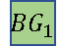







Posterior Probability
$$BG_{1}$$
$$BG_{1}$$
$$BG_{1}$$
$$BG_{1}$$
$$BG_{1}$$
$$BG_{1}$$
$$C$$
$$T$$
$$A$$
$$C$$
$$T$$
$$T$$
$$P\left(y_{t} | x_{1:L}\right)=\frac{P\left(y_{t},x_{1:t}\right)⋅P\left({x_{t+1:L}|y}_{t},x_{1:t}\right) }{P\left(x_{1:t}\right) }$$
$$β_{j,t}:P\left({x_{t+1:L}|y}_{t}\right)$$
Backward Probability
$$β_{j,t}=\sum_{\text{j}\text{′}∈\text{[}\text{m}\text{]}}{β_{\text{j}\text{′}\text{,}\text{t}\text{+}\text{1}}⋅E_{{\text{j}\text{′}\text{,}\text{x}}_{t+1}}⋅T_{\text{j}\text{,}\text{j}\text{′}}}$$

Slide 58

Posterior Probability (HOP-HMM)
$$BG_{1}$$
$$BG_{1}$$
$$BG_{1}$$
$$BG_{1}$$
$$BG_{1}$$
$$BG_{1}$$
$$C$$
$$T$$
$$A$$
$$C$$
$$T$$
$$T$$
$$P\left(y_{t} | x_{1:L}\right)=\frac{P\left(y_{t},x_{1:t}\right)⋅P\left({x_{t+1:L}|y}_{t},x_{1:t}\right) }{P\left(x_{1:t}\right) }$$
$$β_{j,t}:P\left({x_{t+1:L}|y}_{t},x_{1:t}\right)$$
Backward Probability
$$β_{j,t}=\sum_{\text{j}\text{′}∈\text{[}\text{m}\text{]}}{β_{\text{j}\text{′}\text{,}\text{t}\text{+}\text{1}}⋅E_{{\text{j}\text{′}\text{,}\text{x}}_{t+1}}⋅T_{\text{j}\text{,}\text{j}\text{′}}}$$

Slide 59


















Forward Algorithm
$$t\text{−}|W_{1}|\text{−}1$$
$$t\text{−}|W_{2}|\text{−}1$$
$$t$$
$$t\text{−}1$$
$$t$$
$$α_{j,t}$$
$$j$$
$$α_{j,t}$$
$$j$$
Backward Algorithm
$$t$$
$$t\text{−}|W_{2}|\text{−}1$$
$$t\text{−}|W_{1}|\text{−}1$$
$$t$$
$$t\text{+}1$$
$$β_{j,t}$$
$$j$$
$$β_{j,t}$$
$$j$$

Slide 60

































EM (Baum-Welch)
$$x_{1:L}$$
$$C$$
$$A$$
$$C$$
$$G$$
$$T$$
$$G$$
$$T$$
$$T$$
$$A$$
$$G$$
$$A$$
$$T$$
$$T$$
$$A$$
$$A$$
$$G$$
$$C$$
$$A$$
$$C$$
$$G$$
$$T$$
$$G$$
$$T$$
$$A$$
$$A$$
$$G$$
$$C$$
$$A$$
$$C$$
$$G$$
$$T$$
$$G$$
E-step
M-step
$$P$$
$$P\left(y_{t}=BG_{1} | x_{1:L};θ\right)$$
Posterior probability
$$t$$
Parameters $θ$

Slide 61
EM (Baum-Welch)
$$x_{1:L}$$
$$C$$
$$A$$
$$C$$
$$G$$
$$T$$
$$G$$
$$T$$
$$T$$
$$A$$
$$G$$
$$A$$
$$T$$
$$T$$
$$A$$
$$A$$
$$G$$
$$C$$
$$A$$
$$C$$
$$G$$
$$T$$
$$G$$
$$T$$
$$A$$
$$A$$
$$G$$
$$C$$
$$A$$
$$C$$
$$G$$
$$T$$
$$G$$
E-step
M-step
$$P$$
$$P\left(y_{t}=BG_{1} | x_{1:L};θ\right)$$
Posterior probability
$$t$$
Parameters $θ$

Slide 62


Slide 63

EM Regularization

Slide 64


Slide 65


Slide 66


Slide 67

Umbilical Vein Endothelial (E122) vs Monocyte (E124)
H3K27ac
Umbilical Vein
Endothelial
DNase-I
ChromHMM
HOP-HMM
Prediction
Posterior
Probability
Viterbi Path
H3K27ac
Monocyte
DNase-I
ChromHMM
hg19:chr1

Slide 68
Umbilical Vein Endothelial (E122) vs Monocyte (E124)
H3K27ac
Umbilical Vein
Endothelial
DNase-I
ChromHMM
HOP-HMM
Prediction
Posterior
Probability
FOXQ1
FOXD3
FOXD3
Viterbi Path
FOXP1
DIX1
FOXP1
H3K27ac
Monocyte
DNase-I
ChromHMM
hg19:chr1

Slide 69


Gastric (E094) vs Mesendoderm (E004)
H3K27ac
Gastric
DNase-I
ChromHMM
HOP-HMM
Prediction
Posterior Prob.
GSC2
HLTF
HLTF
SRY
Viterbi Path
H3K27ac
Mesendoderm
DNase-I
ChromHMM
hg19:chr5

Slide 70
Mesendoderm (E004) vs Ovary (E097)
H3K27ac
Mesendoderm
DNase-I
ChromHMM
HOP-HMM Prediction
Posterior Probability
POU5F1B
NFATC2
Viterbi Path
H3K27ac
Ovary
DNase-I
ChromHMM
hg19:chr11
HOP-HMM Legend
Mesendoderm State
Ovary State
Background State
Transcription Factor States

